Slide 1
Project 3-Phase 3
Implementation of A* algorithm on a differential drive (non-holonomic) TurtleBot robot (In groups of two)
Deadline – April 3, 11.59PM

Slide 2
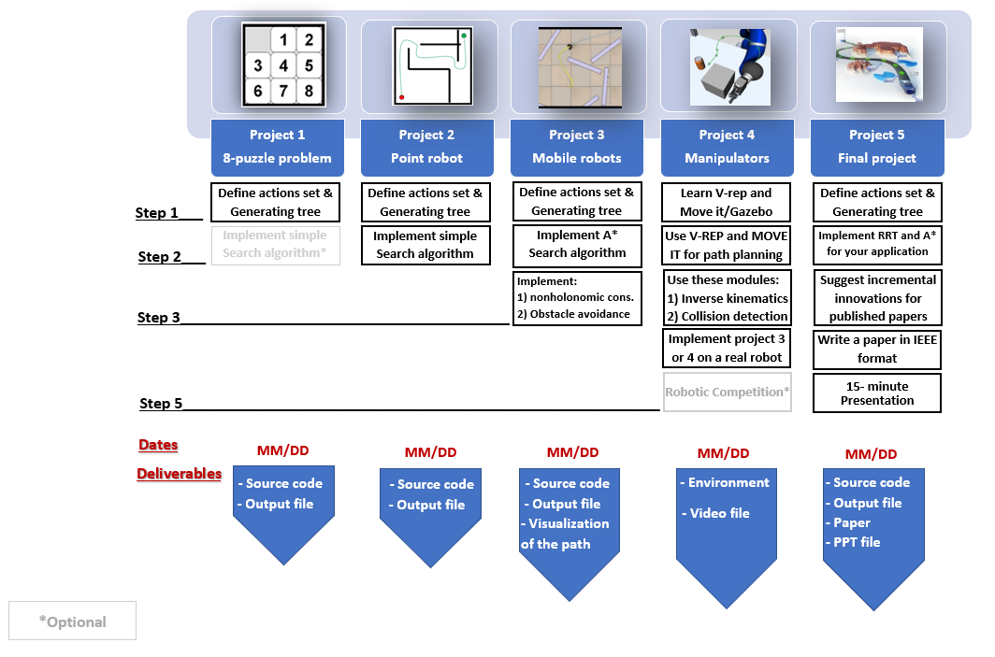
Project3

Slide 3
Project description
Navigate a differential drive robot (TurtleBot 2 / TurtleBot 3) in a given map environment from a given start point to a given goal point.
Consider differential drive constraints while implementing the A* algorithm, with 8-connected action space .

Slide 6
Inputs from the User
Your code must take following values from the user:
Start Point Co-ordinates (3-element vector – x, y, theta)
Goal Point Co-ordinates (2-element vector – x, y)
Wheel RPMs (2-element vector) => Two possible values for the wheel RPMs
Clearance

Slide 7
Parameters to be Defined
Your code must take the following parameters into consideration:
Robot Diameter (from the datasheet)
Wheel Distance –L (to be computed using the datasheet)
Reasonable Clearance
Note that, these parameters are not defined by the user. These are the parameters you need to consider while developing the code.

Slide 8
Project description (Continued..)
Let the two RPMs provided by the user are RPM1 and RPM2 (shown in next slides). Then the action space for the A* algorithm are:
[0, RPM1]
[RPM1, 0]
[RPM1, RPM1]
[0, RPM2]
[RPM2, 0]
[RPM2, RPM2]
[RPM1, RPM2]
[RPM2, RPM1]
Here the first element corresponds to the left wheel RPM and the second element corresponds to the right wheel RPM.

Slide 9
Step 1) Write a subfunction for non-holonomic constraints
This subfunction will take two arguments (Rotational velocity of the left wheel and right wheel) and return the new coordinate of the robot, i.e. (x,y, theta). Where x and y are the translational coordinate of the robot and theta shows the orientation of the robot with respect to axis x.
A sample is provided in the python file. You may choose to modify the function or implement your own.

Slide 10
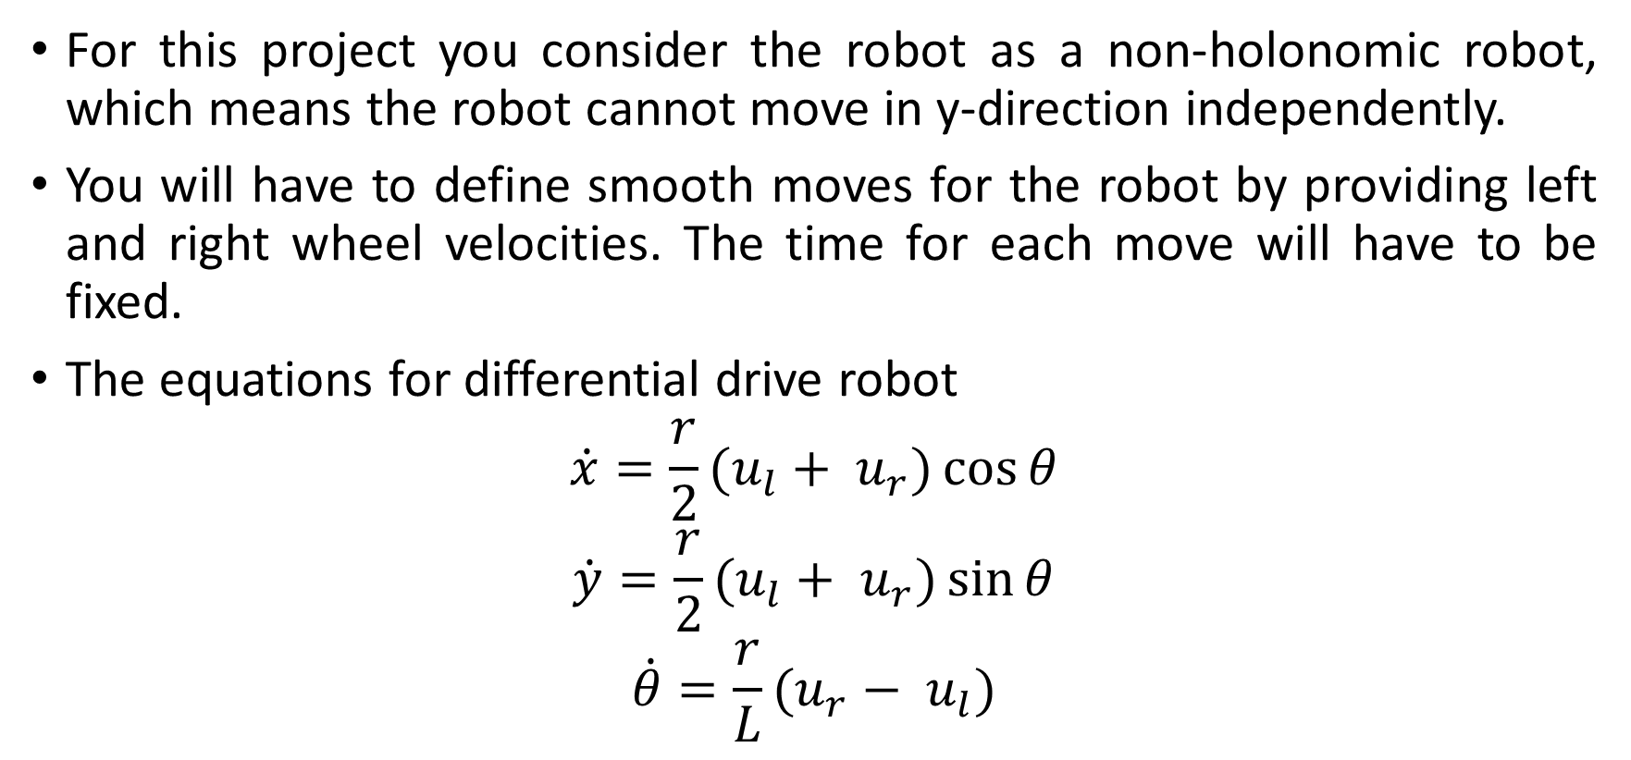
Differential Drive Constraints
For this project you consider the robot as a non-holonomic robot, which means the robot cannot move in y-direction independently.
You will have to define smooth moves for the robot by providing left and right wheel velocities. The time for each move will have to be fixed.
The equations for differential drive robot
$$\dot{x}=\frac{r}{2}(u_{l}+ u_{r})\cos{θ}$$
$$\dot{y}=\frac{r}{2}(u_{l}+ u_{r})\sin{θ}$$
$$\dot{θ}=\frac{r}{L}(u_{r}− u_{l})$$

Slide 11
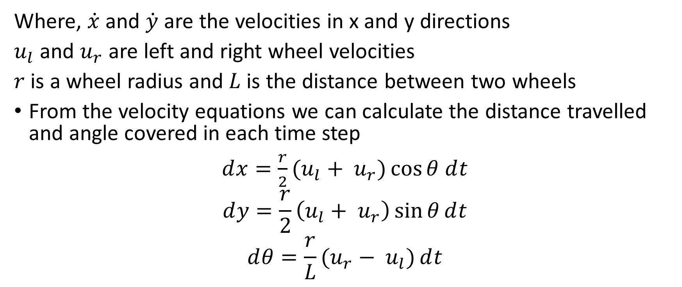
Differential Drive Constraints (Continued..)
Where, $\dot{x}$ and $\dot{y}$ are the velocities in x and y directions
$u_{l}$ and $u_{r}$ are left and right wheel velocities
$r$ is a wheel radius and $L$ is the distance between two wheels
From the velocity equations we can calculate the distance travelled and angle covered in each time step
$ⅆx=\frac{r}{2}(u_{l}+ u_{r})\cos{θ}$ $ⅆt$
$$ⅆy=\frac{r}{2}\left(u_{l}+ u_{r}\right)\sin{θ}ⅆt$$
$$ⅆθ=\frac{r}{L}(u_{r}− u_{l})ⅆt$$

Slide 12
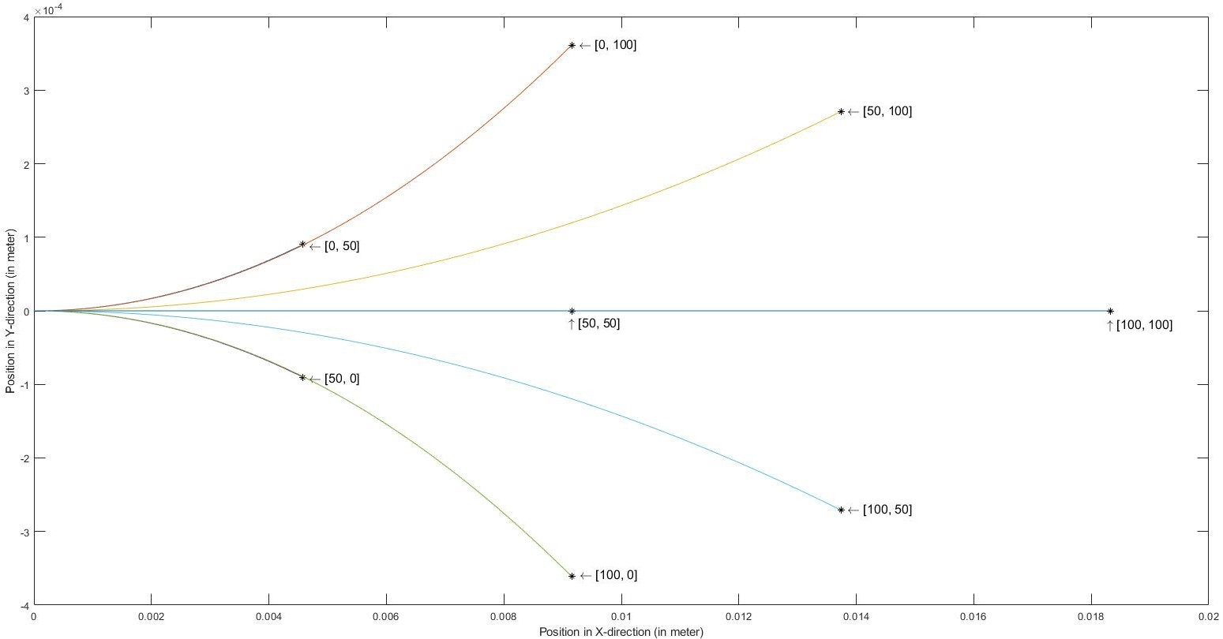
Differential Drive Constraints (Continued..)
The figure shows various curvatures obtained by changing left and right wheel velocities.

Slide 13
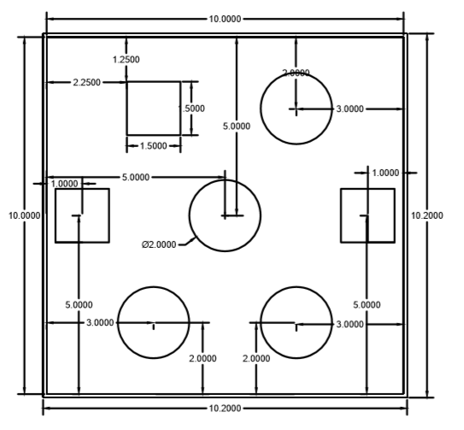
Step 2) Modify the map to consider the geometry of the rigid robot
Dimensions of the robot is available in the datasheet
The center circle is (0,0).

Slide 14
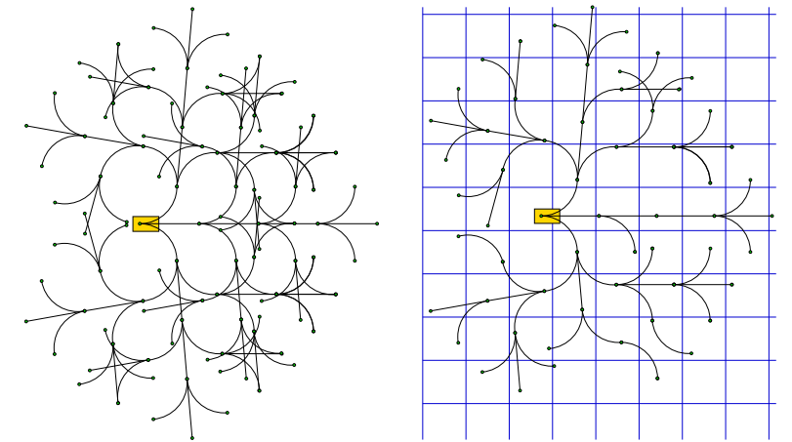
Step 3) Generate the tree using non-holonomic constraints
Consider the configuration space as a 3 dimensional space.
Follow the same step from Project 3- Phase 2 , step 4 to check for duplicate nodes (consider threshold as per your own need, but make sure the 8-action space is not violated).

Slide 15
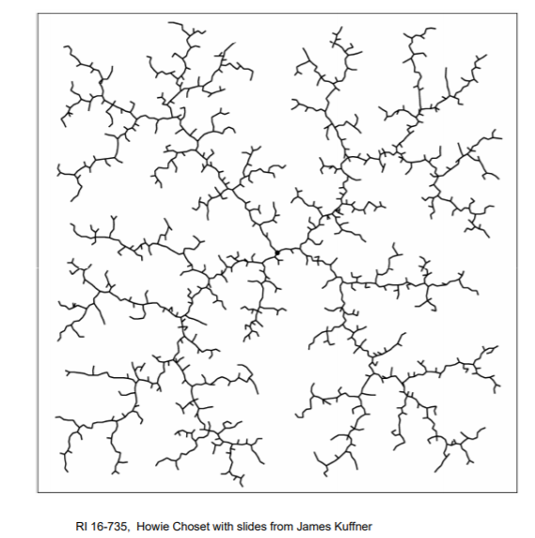
Step 4) Display the tree in the configuration space
Use curve that address the non-holonomic constraints to connect the new node to previous nodes and display it on the Map.

Slide 16
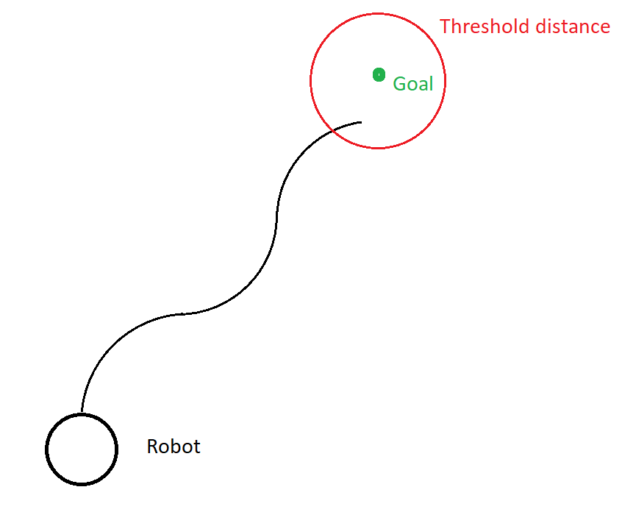
Step 5) implement A* search algorithm to search the tree and to find the optimal path
Consider Euclidean distance as a heuristic function.
Note - You have to define a reasonable threshold value for the distance to the goal point. Due to the limited number of moves, the robot cannot reach the exact goal location, so to terminate the program a threshold distance has to be defined.

Slide 17
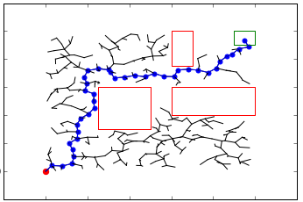
Step 6) Display the optimal path in the map
To plot the final path, you can use ‘quiver’ function as shown in plot_curve in the
shared python file (plot.py).

Slide 18
Submission Details
You are required to submit a zip file with the file structure as shown
proj3_groupnumber_simulationSoftware
code
simulation video
readme.txt
GitHub Link

Slide 19
Video Submission – one video
Give a start point (bottom left) and end point (top right) such that almost all the nodes on the map are being explored.
Decide the clearance and wheel RPM’s on your own.
Mention all the user inputs in the ReadMe.

